Slide 1
Smart Home Lighting System Team 22

Slide 2
Overview
What did we do?
Demo
What are we going to do?

Slide 3
What did we do?
Listed requirments
Bought the hardware
Established working mode for the sensor
Designed UI
Improved our planning

Slide 4
Requirements
Turn the light on/off depending on how bright is in the room
Adjust the number of LED used
Adapt the brightness of LED strip
Implement Google Single Sign On
Use the system on the phone
Make a system optimized
Change the color of LED strip
Log out from system
Turn off the system

Slide 5
Electronics
Hardware
LED Strip
Power supply
Cables
Sensor
LDR
Capacitor
Cables
Fully functional Python program

Slide 6
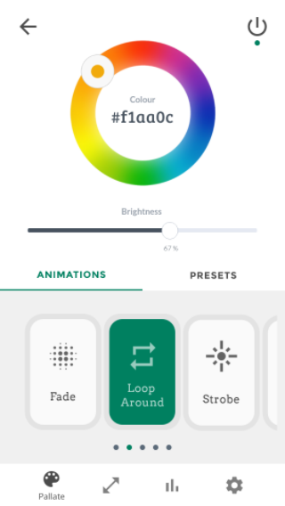
User Interface
Mobile app
User friendly
Responsive
Consistent
Intuitive
Place your screenshot here

Slide 7
DEMO

Slide 8
What are we going to do?
Interconnect UI and LED strip
Manipulate data from the sensor
Implement program that controls LEDs

Slide 9
Thanks!
Any questions?

